Slide 1
INDIAN INSTITUTE OF INFORMATION TECHNOLOGY BHAGALPUR, BIHAR

Slide 2
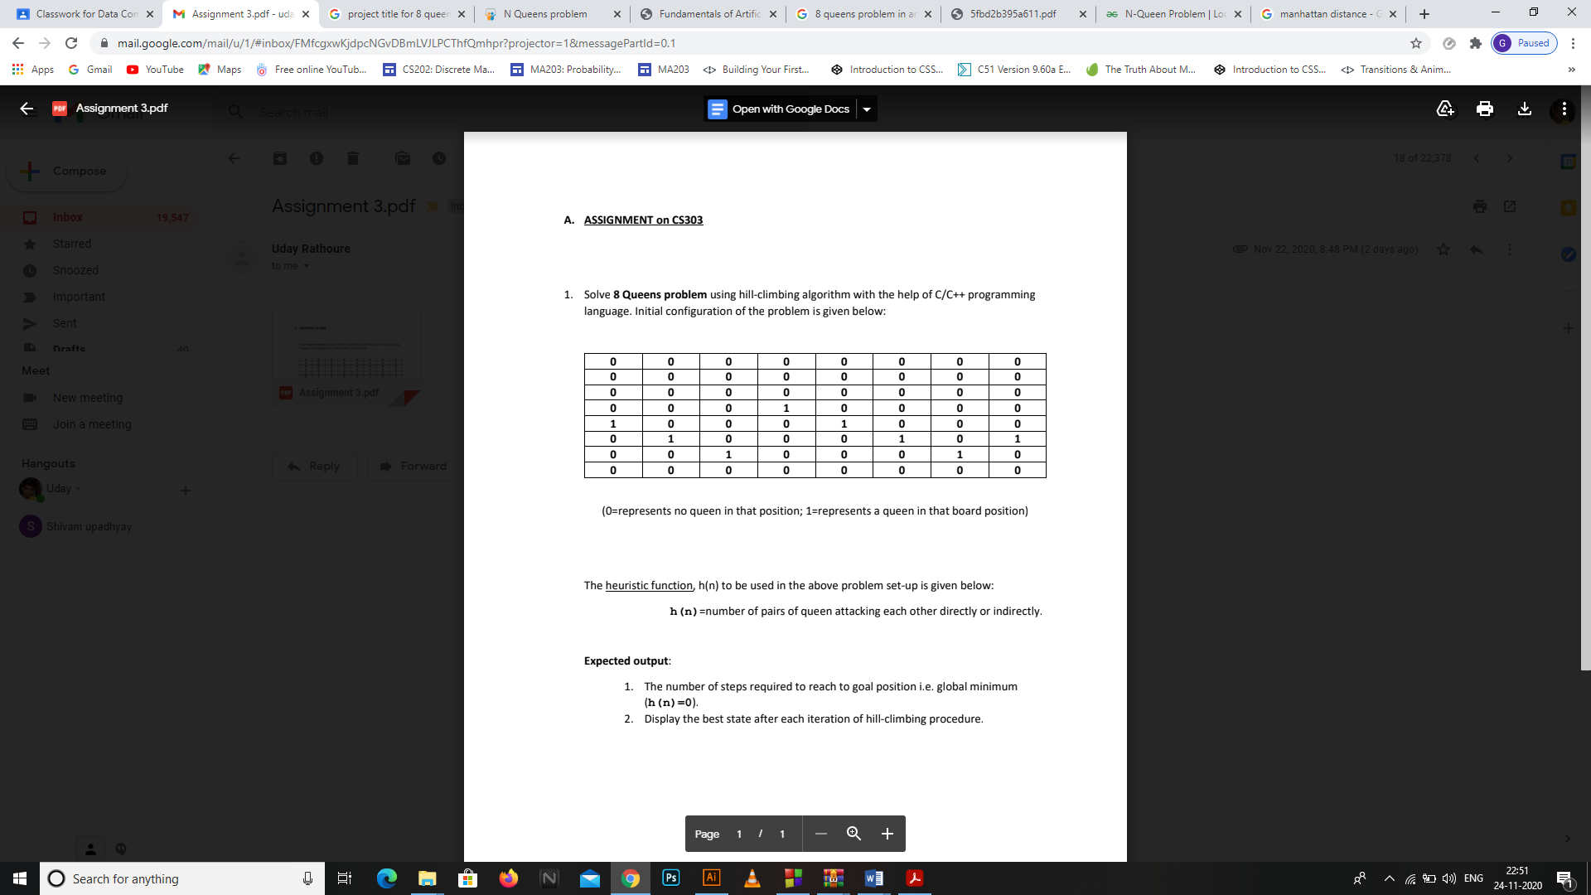
1. Solve 8 Queens problem using hill – climbing algorithm with the help Of C/C++ programming language. Initial configuration of the problem is given below:
The heuristic function, h (n) to be used in the above problem set-up is given below:
h (n) = Number of pairs of Queen attacking each other directly of indirectly.
Expected output:
The number of steps required to reach to goal position i.e. goal minimum (h(n) = 0).
2. Display the best state after each iteration of hill climbing procedure.
Notes:
Jain

Slide 3
INTRODUCTION:
8-Queen Problem is placing 8 queens on an 8 by 8 chessboard so that according to the allowed moves of the queen(Queen can move in any direction i.e. row, column and even diagonally crossing as many squares as it can or have to),none of the Queen is under attack. Problem can be best understood as follows:
Each row can have only one queen.
Each column can have only one queen.
There can be maximum only one queen on a diagonal at a time.
Since the board is symmetric, reflection and rotation can be applied to get solution from known solutions.
8-Queen problem is very expensive to compute because there are all in all 64! = 4.4 x 10^9 [2] total number of possible arrangements of queen. There are 12 unique solutions for an 8 by 8 chessboard and 80 other distinct solutions obtained by rotation and reflection property, summing up to 92. This problem is belongs to special category of problems (NP hard) because its solution cannot be found out in polynomial time. One of the solutions is given below.
Notes:
Jain

Slide 4
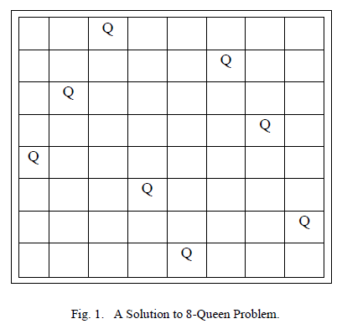
8-Queen puzzle has many applications in scientific and engineering field such as VLSI testing and routing, traffic control, maximum full range communication, parallel optical computing, parallel memory storage schemes, deadlock prevention. Machine learning is one of the most fascinating areas of Artificial Intelligence. It is basically the study of building computer systems which adapt and improves with its experience. Most of the problems of data acquisition are solved by machine learning.
Notes:
jain

Slide 5
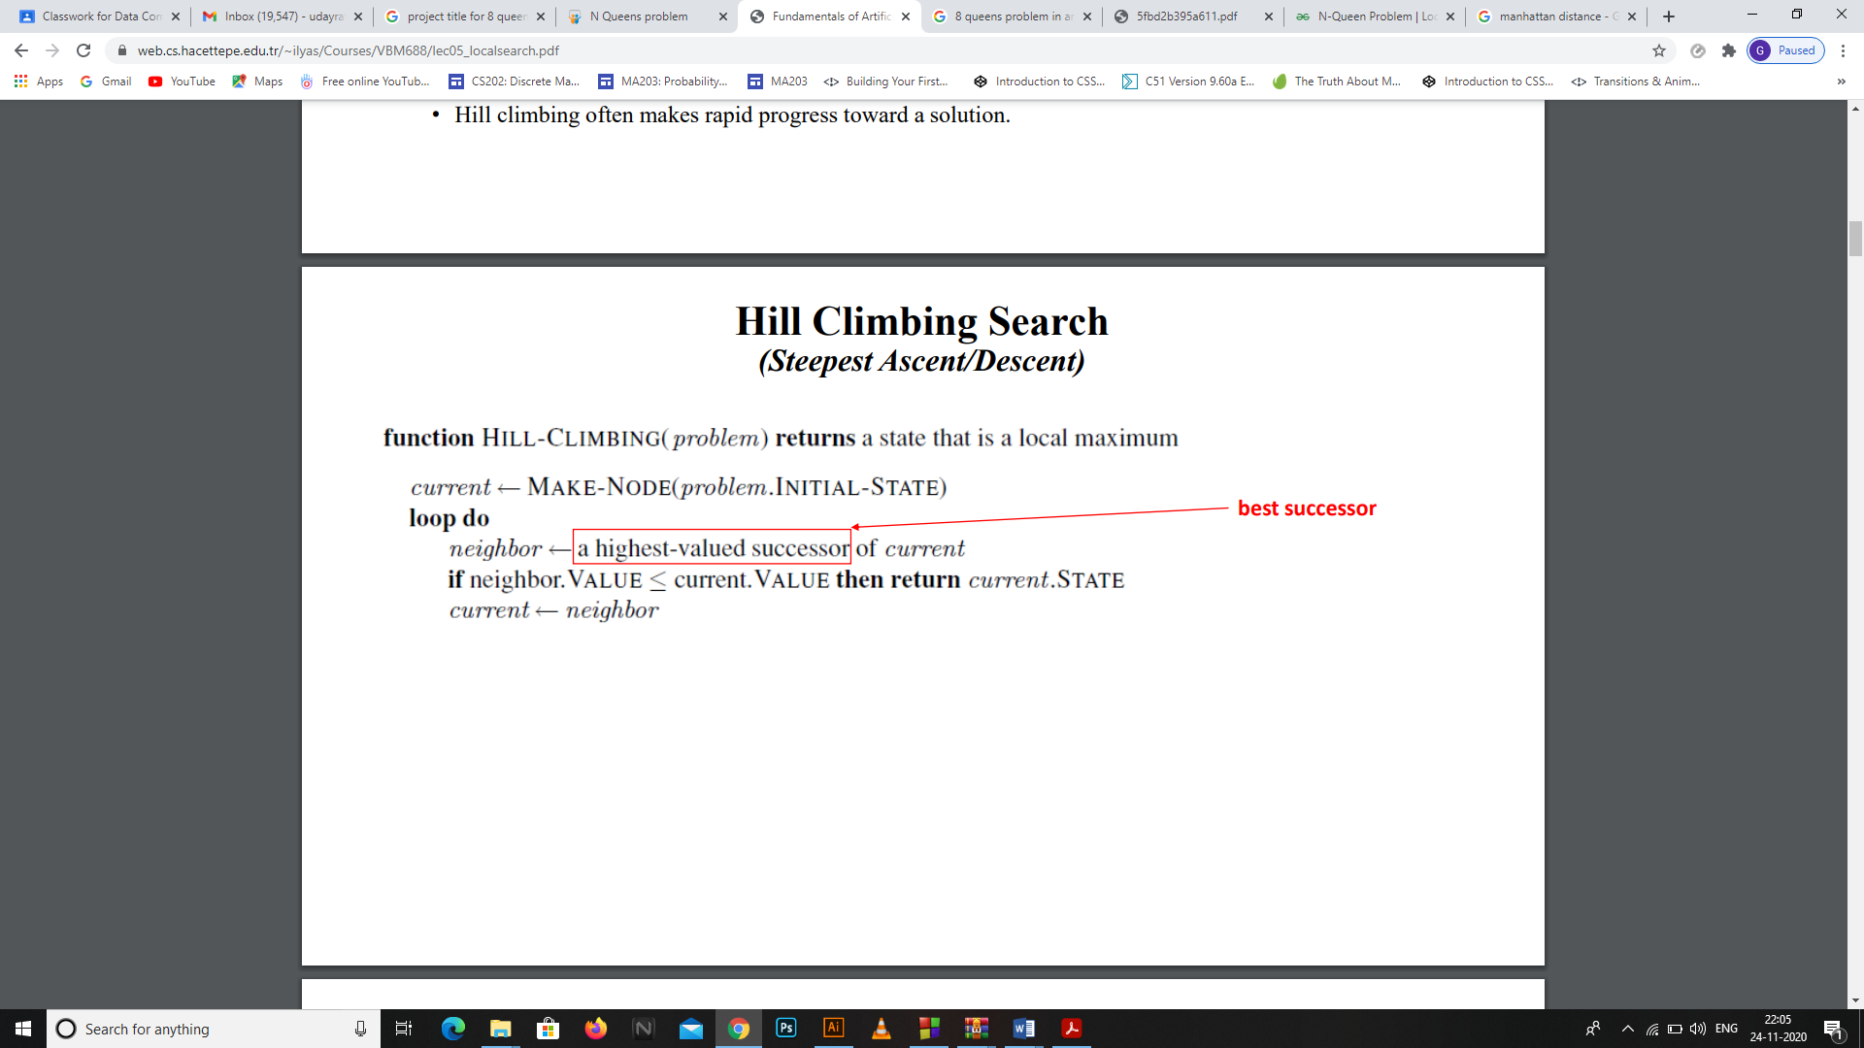
ALGORITHM:
Hill Climbing Search
(Steepest Ascent/Descent)
• At each iteration, the hill-climbing search algorithm moves to the best successor of the current node according to an objective function.
• Best successor is the successor with best value (highest or lowest) according to an objective function.
• If no successors have better value than the current value, it returns.
• It moves in direction of uphill (hill climbing).
• It terminates when it reaches a “peak” where no neighbor has a higher value.
• The algorithm does not maintain a search tree, so the data structure for the current node need only record the state and the value of the objective function.
• Hill climbing does not look ahead beyond the immediate neighbors of the current state.
• Hill climbing is sometimes called greedy local search because it grabs a good neighbor state without thinking ahead about where to go next.
• Greedy algorithms often perform quite well and hill climbing makes rapid progress towards a solution.
Notes:
Ankush

Slide 6
Types of Hill Climbing
SIMPLE HILL CLIMBING
It examines the neighboring nodes one by one and selects the first neighboring node which optimizes the current cost as next node.
Steepest-Ascent Hill climbing: It first examines all the neighboring nodes and then selects the node closest to the solution state as of next node.
Stochastic hill climbing : It does not examine all the neighboring nodes before deciding which node to select .It just selects a neighboring node at random and decides (based on the amount of improvement in that neighbor) whether to move to that neighbor or to examine another.
Notes:
Tanveer

Slide 7
Why Steepest-Ascent Hill climbing?
Steepest-Ascent Hill climbing:- We have used this because we need neighbouring state with minimum optimised value( the minimum number of attacking pairs) and here we need to reach the global maximum which will be peak value that is h(n)=0
Notes:
Udya

Slide 8
ADVANTAGES:
Hill Climbing can be used in continuous as well as domains.
Hill climbing technique is very useful in job shop scheduling, automatic programming, circuit designing, and vehicle routing.
3. Hill climbing is also helpful to solve pure optimization problems where the objective is to find the best state according to the objective function.
4. It requires less memory and is fast.
Notes:
Sanjana

Slide 9
Disadvantages
Hill-Climbing can’t reach to desired state when it reaches any of the following states:-
Local Maximum: At a local maximum all neighboring states have values worse current state. Since hill-climbing uses greedy approach so it won’t go to next (worse) state. The process will end even if there is a better solution (global maximum) exists.
Plateau: On a plateau all neighboring states have same value so it’s difficult to determine which is best direction to proceed.
Ridge: Any point on a ridge can look like a peak because all paths from ridge goes to downward direction. Therefore, algorithm when it reaches this state.
Notes:
Dhruv

Slide 10
How these disadvantages come into picture in our project?
Local maximum : At a local maximum all neighboring states have a values which is worse than the current state. Since hill-climbing uses a greedy approach, it will not move to the worse state and terminate itself. The process will end even though a better solution may exist.
Plateau : On plateau all neighbors have same value . Hence, it is not possible to select the best direction.
Ridge : Any point on a ridge can look like peak because movement in all possible directions is downward. Hence the algorithm stops when it reaches this state.
Notes:
Sourav

Slide 11
How we dealt with it?
To overcome local maximum problem : Utilize backtracking technique. Maintain a list of visited states. If the search reaches an undesirable state, it can backtrack to the previous configuration and explore a new path.
To overcome plateaus : Make a big jump. Randomly select a state far away from the current state. Chances are that we will land at a non-plateau region
To overcome Ridge : In this kind of obstacle, use two or more rules before testing. It implies moving in several directions at once.
Notes:
Sourav next

Slide 12

To understand local search, it is useful to consider the state-space landscape.
The aim is to find the highest peak - a global maximum.
Hill-climbing search modifies the current state to try to improve it.
A local maximum is a peak that is higher than each of its neighboring states but lower than the global maximum.
Hill-climbing algorithms that reach the vicinity of a local maximum will be drawn upward toward the peak but will then be stuck with nowhere else to go.
A plateau is a flat area of the state-space landscape. It can be a flat local maximum, from which no uphill exit exists, or a shoulder, from which progress is possible.
A hill-climbing search might get lost on the plateau.
• Random sideways moves can escape from shoulders but they loop forever on flat maxima.

Slide 13
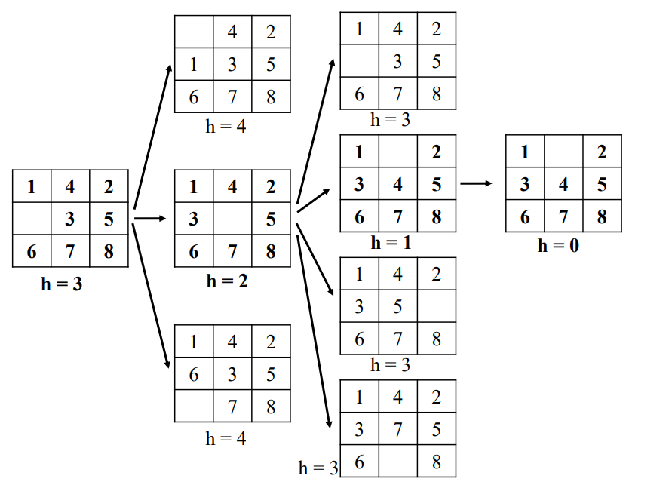
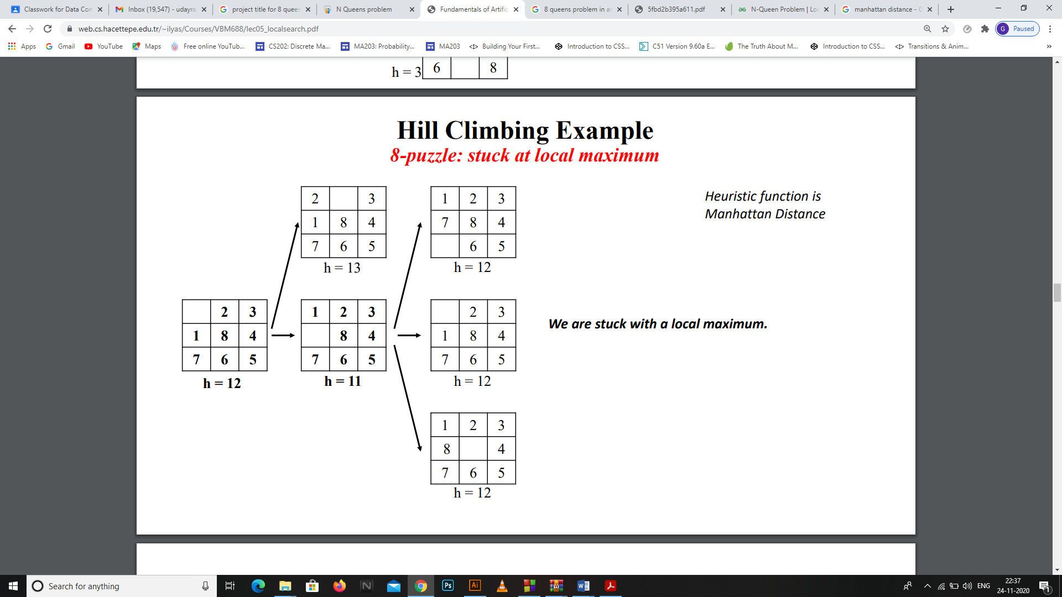
Hill Climbing Example
8-puzzle: a solution case
Hill Climbing Example
8-puzzle: stuck at local maximum

Slide 14
PROGRAM CODE:
#include <iostream>
#include <math.h>
#define N 8
using namespace std;
// A utility function that prints
// the 2D array "board".
void printBoard(int board[][N])
{
for (int i = 0; i < N; i++) {
cout << " ";
for (int j = 0; j < N; j++) {
cout << board[i][j] << " ";
}
cout << "\n";
}}
// A utility function that printsthe array "state".
void printState(int* state)
{
Notes:
Sachin, Neeraj, Gokul

Slide 15
for (int i = 0; i < N; i++) {
cout << " " << state[i] << " ";
}
cout << endl;
}
// A utility function that compares two arrays, state1 and state2 and returns true if equal and false otherwise.
bool compareStates(int* state1,
int* state2)
{
for (int i = 0; i < N; i++) {
if (state1[i] != state2[i]) {
return false;
}}
return true;
}
// A utility function that fills the 2D array "board" with values "value"
void fill(int board[][N], int value)

Slide 16
for (int i = 0; i < N; i++) {
for (int j = 0; j < N; j++) {
board[i][j] = value;
}
}
}
// This function calculates the objective value of the
// state(queens attacking each other)
// using the board by the
// following logic.
int calculateHuristic(int board[][N],
int* state)
{
// For each queen in a column, we check for other queens falling in the line of our current queen and if found, any, then we increment the variable attacking count.
// Number of queens attacking each other,initially zero.
int attacking = 0;
// Variables to index a particular row and column on board.
int row, col;

Slide 17
for (int i = 0; i < N; i++) {
// At each column 'i', the queen is
// placed at row 'state[i]', by the
// definition of our state.
// To the left of same row
// (row remains constant
// and col decreases)
row = state[i], col = i - 1;
while (col >= 0
&& board[row][col] != 1) {
col--;
}
if (col >= 0
&& board[row][col] == 1) {
attacking++;
}
// Diagonally to the left up
// (row and col simoultaneously
// decrease)

Slide 18
row = state[i] - 1, col = i - 1;
while (col >= 0 && row >= 0
&& board[row][col] != 1) {
col--;
row--;
}
if (col >= 0 && row >= 0
&& board[row][col] == 1) {
attacking++;
}
// Diagonally to the right down
// (row and col simoultaneously
// increase)
row = state[i] + 1, col = i + 1;
while (col < N && row < N
&& board[row][col] != 1) {
col++;
row++;
}
if (col < N && row < N
&& board[row][col] == 1) {
attacking++;
}

Slide 19
// Diagonally to the left down
// (col decreases and row
// increases)
row = state[i] + 1, col = i - 1;
while (col >= 0 && row < N
&& board[row][col] != 1) {
col--;
row++;
}
if (col >= 0 && row < N
&& board[row][col] == 1) {
attacking++;
}
// Diagonally to the right up
// (col increases and row
// decreases)
row = state[i] - 1, col = i + 1;
while (col < N && row >= 0
&& board[row][col] != 1) {
col++;
row--;
}

Slide 20
if (col < N && row >= 0
&& board[row][col] == 1) {
attacking++;
}
}
// Return pairs.
return (int)(attacking / 2);
}
// A utility function that
// generates a board configuration
// given the state.
void generateBoard(int board[][N],
int* state)
{
fill(board, 0);
for (int i = 0; i < N; i++) {
board[state[i]][i] = 1;
}
}

Slide 21
// A utility function that copies
// contents of state2 to state1.
void copyState(int* state1, int* state2)
{
for (int i = 0; i < N; i++) {
state1[i] = state2[i];
}
}
// This function gets the neighbour
// of the current state having
// the least objective value
// amongst all neighbours as
// well as the current state.
void getNeighbour(int board[][N],
int* state)
{
// Declaring and initializing the
// optimal board and state with
// the current board and the state
// as the starting point.

Slide 22
int opBoard[N][N];
int opState[N];
copyState(opState,
state);
generateBoard(opBoard,
opState);
// Initializing the optimal
// objective value
int opHuristic
= calculateHuristic(opBoard,
opState);
// Declaring and initializing
// the temporary board and
// state for the purpose
// of computation.
int NeighbourBoard[N][N];
int NeighbourState[N];

Slide 23
copyState(NeighbourState,
state);
generateBoard(NeighbourBoard,
NeighbourState);
// Iterating through all
// possible neighbours
// of the board.
for (int i = 0; i < N; i++) {
for (int j = 0; j < N; j++) {
// Condition for skipping the
// current state
if (j != state[i]) {
// Initializing temporary neighbour with the current neighbour.
NeighbourState[i] = j;
NeighbourBoard[NeighbourState[i]][i]
= 1;
NeighbourBoard[state[i]][i]=0;

Slide 24
// Calculating the objective
// value of the neighbour.
int temp
= calculateHuristic(
NeighbourBoard,
NeighbourState);
// Comparing temporary and optimal
// neighbour objectives and if
// temporary is less than optimal
// then updating accordingly.
if (temp <= opHuristic) {
opHuristic = temp;
copyState(opState,
NeighbourState);
generateBoard(opBoard,
opState);
}
// Going back to the original
// configuration for the next
// iteration.

Slide 25
NeighbourBoard[NeighbourState[i]][i]
= 0;
NeighbourState[i] = state[i];
NeighbourBoard[state[i]][i] = 1;
}
}
}
// Copying the optimal board and
// state thus found to the current
// board and, state since c++ doesn't
// allow returning multiple values.
copyState(state, opState);
fill(board, 0);
generateBoard(board, state);
}
void hillClimbing(int board[][N],
int* state)
{
// Declaring and initializing the neighbour board and state with the current board and the state as the starting point.

Slide 26
int neighbourBoard[N][N] = {};
int neighbourState[N];
int count=0;
copyState(neighbourState, state);
generateBoard(neighbourBoard,
neighbourState);
do {
// Copying the neighbour board and
// state to the current board and
// state, since a neighbour
// becomes current after the jump.
copyState(state, neighbourState);
generateBoard(board, state);
// Getting the optimal neighbour
getNeighbour(neighbourBoard,
neighbourState);

Slide 27
int temp= calculateHuristic(neighbourBoard,neighbourState);
cout<<"\n";
printBoard(neighbourBoard);
cout<<"no of pairs of queens attacking each other in upper state are : "<<temp<<endl;
count++;
if (compareStates(state,
neighbourState)) {
// If neighbour and current are
// equal then no optimal neighbour
// exists and therefore output the
// result and break the loop.printBoard(board);
cout<<"number of steps taken are : "<<count<<endl;
break;
}
else if (calculateHuristic(board,
state)
== calculateHuristic(
neighbourBoard,
neighbourState)) {

Slide 28
// If neighbour and current are
// not equal but their objectives
// are equal then we are either
// approaching a shoulder or a
// local optimum, in any case,
// jump to a random neighbour
// to escape it.
// Random neighbour
neighbourState[rand() % N]
= rand() % N;
generateBoard(neighbourBoard,
neighbourState);
}
} while (true);
}
// Driver code

Slide 29
int main()
{
int state[N] = {};
int board[N][N] = {};
cout<<"enter the initial postions\n";
int temp;
for(int i=0;i<N;i++)
{
for(int j=0;j<N;j++)
{
cin>>temp;
board[i][j]=temp;
if(temp==1)
state[j]=i;
}
}
hillClimbing(board, state);
return 0;
}

Slide 30
Output:
enter the initial postions
1 1 1 1 1 1 0 1
0 0 0 0 0 0 0 0
0 0 0 0 0 0 0 0
0 0 0 0 0 0 0 0
0 0 0 0 0 0 0 0
0 0 0 0 0 0 0 0
0 0 0 0 0 0 0 0
0 0 0 0 0 0 1 0
no of pairs of queens attacking each other in upper state are : 6
1 1 1 1 1 1 0 0
0 0 0 0 0 0 0 1
0 0 0 0 0 0 0 0
0 0 0 0 0 0 0 0
0 0 0 0 0 0 0 0
0 0 0 0 0 0 0 0
0 0 0 0 0 0 0 0
0 0 0 0 0 0 1 0
no of pairs of queens attacking each other in upper state are : 5

Slide 31
1 1 1 1 0 1 0 0
0 0 0 0 0 0 0 1
0 0 0 0 0 0 0 0
0 0 0 0 0 0 0 0
0 0 0 0 0 0 0 0
0 0 0 0 0 0 0 0
0 0 0 0 1 0 0 0
0 0 0 0 0 0 1 0
no of pairs of queens attacking each other in upper state are : 4
1 1 0 1 0 1 0 0
0 0 0 0 0 0 0 1
0 0 0 0 0 0 0 0
0 0 0 0 0 0 0 0
0 0 0 0 0 0 0 0
0 0 1 0 0 0 0 0
0 0 0 0 1 0 0 0
0 0 0 0 0 0 1 0
no of pairs of queens attacking each other in upper state are : 3

Slide 32
0 1 0 1 0 1 0 0
0 0 0 0 0 0 0 1
0 0 0 0 0 0 0 0
0 0 0 0 0 0 0 0
1 0 0 0 0 0 0 0
0 0 1 0 0 0 0 0
0 0 0 0 1 0 0 0
0 0 0 0 0 0 1 0
no of pairs of queens attacking each other in upper state are : 2
0 1 0 0 0 1 0 0
0 0 0 0 0 0 0 1
0 0 0 0 0 0 0 0
0 0 0 1 0 0 0 0
1 0 0 0 0 0 0 0
0 0 1 0 0 0 0 0
0 0 0 0 1 0 0 0
0 0 0 0 0 0 1 0
no of pairs of queens attacking each other in upper state are : 1

Slide 33
0 1 0 0 0 0 0 0
0 0 0 0 0 0 0 1
0 0 0 0 0 1 0 0
0 0 0 1 0 0 0 0
1 0 0 0 0 0 0 0
0 0 1 0 0 0 0 0
0 0 0 0 1 0 0 0
0 0 0 0 0 0 1 0
no of pairs of queens attacking each other in upper state are : 1
0 1 0 0 0 0 0 0
0 0 0 0 0 0 0 1
0 0 0 0 0 1 0 0
0 0 0 1 0 0 0 0
1 0 0 0 0 0 0 0
0 0 1 0 0 0 0 0
0 0 0 0 1 0 0 0
0 0 0 0 0 0 1 0
no of pairs of queens attacking each other in upper state are : 1

Slide 34
0 1 0 0 0 1 0 0
0 0 0 0 0 0 0 1
0 0 0 0 0 0 0 0
0 0 0 1 0 0 0 0
1 0 0 0 0 0 0 0
0 0 1 0 0 0 0 0
0 0 0 0 1 0 0 0
0 0 0 0 0 0 1 0
no of pairs of queens attacking each other in upper state are : 1
0 0 0 0 0 1 0 0
0 0 0 0 0 0 0 1
0 1 0 0 0 0 0 0
0 0 0 1 0 0 0 0
1 0 0 0 0 0 0 0
0 0 1 0 0 0 0 0
0 0 0 0 1 0 0 0
0 0 0 0 0 0 1 0
no of pairs of queens attacking each other in upper state are : 1

Slide 35
0 0 0 0 0 1 0 0
0 0 0 0 0 0 0 1
0 1 0 0 0 0 0 0
0 0 0 1 0 0 0 0
1 0 0 0 0 0 0 0
0 0 1 0 0 0 1 0
0 0 0 0 1 0 0 0
0 0 0 0 0 0 0 0
no of pairs of queens attacking each other in upper state are : 1
0 0 0 0 0 1 0 0
0 0 0 0 0 0 0 1
0 1 0 0 0 0 0 0
0 0 0 1 0 0 0 0
1 0 0 0 0 0 0 0
0 0 1 0 0 0 1 0
0 0 0 0 1 0 0 0
0 0 0 0 0 0 0 0
no of pairs of queens attacking each other in upper state are : 1

Slide 36
0 0 0 0 0 1 0 0
0 0 0 0 0 0 0 1
0 1 0 0 0 0 0 0
0 0 0 1 0 0 0 0
1 0 0 0 0 0 0 0
0 0 0 0 0 0 1 0
0 0 0 0 1 0 0 0
0 0 1 0 0 0 0 0
no of pairs of queens attacking each other in upper state are : 0
0 0 0 0 0 1 0 0
0 0 0 0 0 0 0 1
0 1 0 0 0 0 0 0
0 0 0 1 0 0 0 0
1 0 0 0 0 0 0 0
0 0 0 0 0 0 1 0
0 0 0 0 1 0 0 0
0 0 1 0 0 0 0 0
no of pairs of queens attacking each other in upper state are : 0
number of steps taken are : 14

